Slide 1
Page Setup
Set up the first page of every lesson like this and rule a column line for every page after the first page that is used during the lesson.
Focus: State the Chapter Number, Title and the page numbers (3 lines).
Keywords: During the lesson write out your own keywords used during the lesson. (8 lines)
Context: During the lesson write in this section what this topic relates to in the ‘real’ world. How is this content used to better society? (5 lines)

Slide 2
Kinetic and Internal Energy
Chapter 1.1 page 4 - 9

Slide 3
KINETIC THEORY
Kinetic Theory states that the tiny particles in all forms of matter are in constant motion.
Solid: particles vibrate about a fixed position.
Liquids: particles move about a fixed position as the position itself moves about the liquid.
Gases: particles have sufficient kinetic energy to escape the attractive forces of other particles and move more freely.

Slide 4
KINETIC THEORY
Kinetic Theory applies where heating causes particles, within the material, to gain Kinetic energy (move or vibrate at greater speeds) and gain Potential energy (by moving further from their position of equilibrium).
This allows for a change in state to occur (solid → liquid → gas) where there is enough energy added to break the strong inter-particle forces.

Slide 5
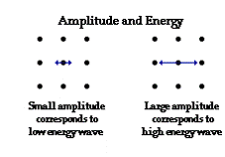
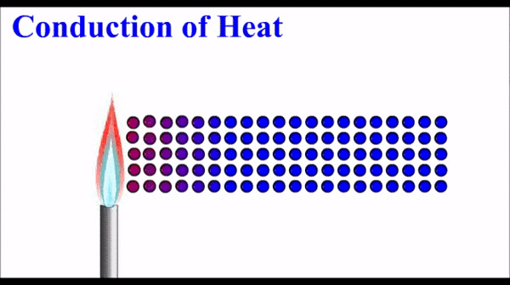
Kinetic and Potential Energy

Slide 6
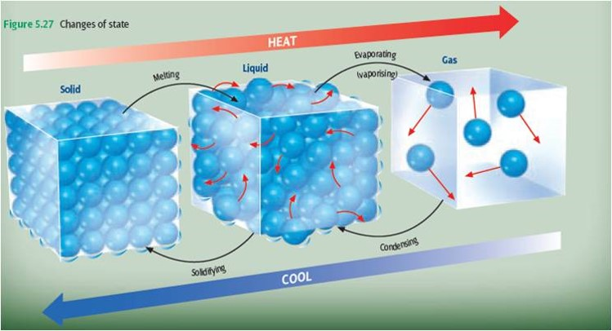
STATES OF MATTER

Slide 7
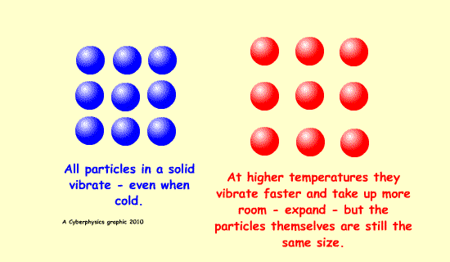
Expansion
An increase in temperature will cause the particles to vibrate more as the Kinetic Energy increases. This causes the particles to move further apart, hence the material expands when heated (gains energy) and
contracts when
cooled (loses
energy).

Slide 8
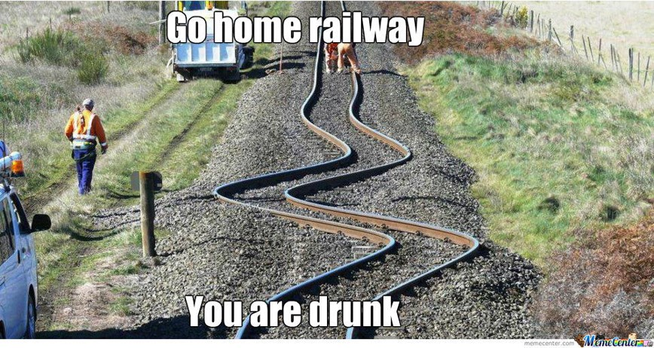
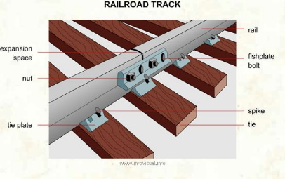
Expansion in Solids
Expansion in solids can cause structural damage if allowances are not made. Railway lines, for example, are not laid in one continuous strip, but have small gaps that allow for movement due to changes in temperature. The rails are connected with fishplates.

Slide 9
Heat, Temperature & Internal Energy
Temperature is the measure of the average kinetic energy of all the particles within the material or object.
Heat is the amount of energy transferred due to the difference in temperature.
Internal Energy is the total kinetic energy and potential energy

Slide 10
Homework, Context & Keywords
Context: How is this content used to better society?
The understanding the principles behind Internal energy and Kinetic energy better explains the environmental issues of today.

Slide 11
Homework, Context & Keywords
Key Words
Internal energy
Kinetic energy
Change of States

Slide 12
Homework, Context & Keywords
Homework
Complete all questions from Set 1.1 - due first lesson next week.
Read Chapter 1.2, page 10-13 and answer
Q1&2 Set 1.2
by next lesson.

Slide 13
Page Setup
Set up the first page of every lesson like this and rule a column line for every page after the first page that is used during the lesson.
Focus: State the Chapter Number, Title and the page numbers (3 lines).
Keywords: During the lesson write out your own keywords used during the lesson. (8 lines)
Context: During the lesson write in this section what this topic relates to in the ‘real’ world. How is this content used to better society? (5 lines)

Slide 14
Temperature and Thermal Equilibrium
Chapter 1.2 page 10 - 13

Slide 15
Temperature, Internal Energy and Heat Differences
Temperature is the degree or intensity of heat present in a substance or object, expressed in terms of any of several arbitrary scales like Celsius.
Internal energy is defined by the amount of kinetic energy available and the amount of potential energy stored within the isolated system.
Heat is energy that is transferred from one object to another as the result of a difference in temperature.

Slide 16
Temperature and Heat Differences
Hot drink in a cup versus a warm bath.
Temperature is higher in the hot drink since the average kinetic energy of particles is high.
Heat is transferred to the surroundings is greatest from the warm bath due to the greater surface area allowing the transfer of heat.

Slide 17
Absolute Temperature
Absolute Zero (0 Kelvin) = -273ºC
1 Kelvin increase = 1ºC increase
Formula: x K = 273 + y ºC
Example
Convert 26ºC to the equivalent Kelvin.
Solution: Kelvin = 273 + 26 = 299 K
Convert 319 K to the equivalent Celsius
Solution: Celsius = 319 - 273 = 46ºC

Slide 18
Heat
Heat is transferred or transformed.
Cold is not a form of energy.
Heat is the movement of thermal energy from a substance at a higher temperature to another substance at a lower temperature.
The ability to do work or cause change.
Hence is measured in Joules.

Slide 19
Calculations
Work = Force × Displacement (W = Fs)
Work (Joules)
Force (Newtons)
Displacement (Metres)
Power = Energy P = E
Time t
Power (Watts)
Energy (Joules)
Time (Seconds)

Slide 20
Example 1.2a
A family arrives home from holidays and switches on their 3.5 kW water heater, which heater, which contains 150 litres of water at 20ºC. How long will it be before the family can have a shower if the water needs to be 40ºC and the heat needed is 1.254 x 10⁷J?
Solution
Heat supplied (Energy) E = P x t
1.254 × 10⁷ = 3500 × t
t = 3583 s

Slide 21

Thermal Equilibrium
This is where two or more objects of different temperature are placed in an isolated system. The objects will gain or lose Kinetic energy to the other system, until both have an equal temperature.

Slide 22
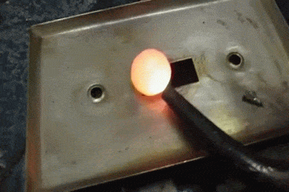
Fact
If a piece of hot metal is placed into a beaker of cold water, then the heat from the metal will transfer to the water.
The temperature of the water will rise and the temperature of the
metal will fall, until
thermal equilibrium
is reached.

Slide 23
Fact: Kinetic Theory
In terms of Kinetic Theory;
the average kinetic energy of the atoms of the metal has decreased and
the average kinetic energy of the atoms of the water has increased.

Slide 24
Fact: Thermal Equilibrium
In terms of equilibrium:
Heat lost by metal = Heat gained by water
(The final average Kinetic Energy of the particles for both water and metal will be the same)

Slide 25
Homework, Context & Keywords
Context: How is this content used to better society?
The understanding the principles behind Heat and Temperature in relation to Kinetic Theory and Thermal Equilibrium to better explains the environmental effects to humans.

Slide 26
Homework, Context & Keywords
Key Words
Kinetic Theory
Thermal Equilibrium
Temperature
Heat
Kelvin
Absolute Zero

Slide 27
Homework, Context & Keywords
Homework
Complete all questions from Set 1.2 - due first lesson next week.
Read Chapter 1.3, page 13-20 and answer
Q1 Set 1.3
by next lesson.

Slide 28
Page Setup
Set up the first page of every lesson like this and rule a column line for every page after the first page that is used during the lesson.
Focus: State the Chapter Number, Title and the page numbers (3 lines).
Keywords: During the lesson write out your own keywords used during the lesson. (8 lines)
Context: During the lesson write in this section what this topic relates to in the ‘real’ world. How is this content used to better society? (5 lines)

Slide 29
Specific Heat Capacity
Chapter 1.3 page 13-20
2 lessons

Slide 30
The specific heat capacity of a substance is the amount of heat required to raise the temperature of 1.0kg of that substance by 1.0 ºC.
To calculate the heat required to change the temperature of a substance, then;
Q = m c ∆T
Q = quantity of heat energy (J)
m = mass (kg)
c = specific heat (J kg⁻¹ K⁻¹)
∆T = temperature change (K)
Q = m c ∆T

Slide 31
The specific heat capacity of a substance is the amount of heat required to raise the temperature of 1.0kg of that substance by 1.0 ºC.
Specific heat is the energy (heat) required to raise the temperature of an object.
Example
Specific Heat Capacity of Water is 4180 J kg⁻¹ K⁻¹.
So the Specific Heat of a 2 kg amount of water is 2 × 4180 = 8360 J K⁻¹.

Slide 32
SOME SPECIFIC HEAT CAPACITIES
substance | c (J kg⁻¹ K⁻¹)
water
4180
ice
2100
copper
380
iron
435
aluminium
880
ethanol
2500
paraffin
2140
human body
3500
air
1010

Slide 33
Example 1.3a
A kettle is filled with tap water which is at a temperature of 22.0ºC. If the mass of the water is 1.85 kg, calculate the heat required to raise the temperature to 100ºC.
Solution
Q = ?
m = 1.85 kg
c = 4180 J kg⁻¹ K⁻¹
∆T = (100 – 22)
= 78 K
∆T = (373 – 295)
= 78 K
Q = mc ∆T
= 1.85 x 4180 x 78
= 6.03 x 10⁵ J

Slide 34
Example 1.3a
With the kettle boiling the water, what assumptions are made?
Solution
No heat is lost to its surroundings, that is, it is an isolated system.

Slide 35
Example 1.3b
2 kW
immersion heater
What will be the temperature of the water after 2 minutes, given the specific heat capacity of water is 4200 J kg⁻¹ K⁻¹?
2000 g of water
At 20⁰ C
Solution
Energy = Power x Time
= 2000 x 2 x 60
= 240 000 J
Q = 240000
m = 2 kg
c = 4200 J kg⁻¹ K⁻¹
∆T = ?
240000 = 2 x 4200 x ∆T
∆T = 28.6
T = 20 + 28.6
= 48.6 ºC

Slide 36
Example 1.3b
2 kW
immersion heater
In reality the final temperature would be lower than this. Why?
2000 g of water
At 20⁰ C
Solution
Heat lost to the surroundings.
Heat absorbed by the vessel.

Slide 37
Example 1.3c
The two disk brakes of a 600 kg motorbike each have a mass of 1 kg. The motorbike brakes to a stop from 30 ms⁻¹. If 50% of the bike’s Kinetic energy is transferred to the disks, calculate their rise in temperature. c = 500 J kg⁻¹ K⁻¹?
Solution
50% of E_{k} of bike = Heat energy of brakes
50% × ½ × m × v² = m × c × ∆T
50% × ½ × 600 × 30² = 2 × 500 × ∆T
∆T = 135 K

Slide 38
Example 1.3d
A 0.650 kg block of copper metal is initially heated to 100 ºC (in boiling water), and then placed into 500 g of cold water at 15 ºC (without the boiling water).
Assuming no heat is lost to the surroundings, determine the final temperature of the copper and the water.
c_{c} = 390 J kg⁻¹ K⁻¹ c_{w} = 4180 J kg⁻¹ K⁻¹

Slide 39
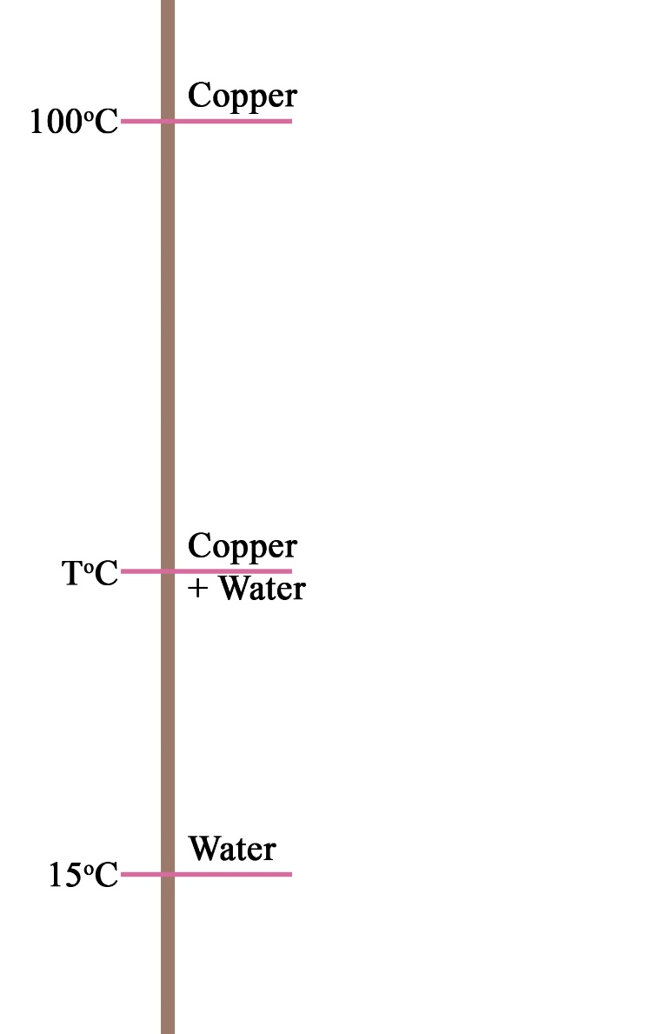
Example 1.3d
Step 1: Draw a diagram representing the information.

Slide 40
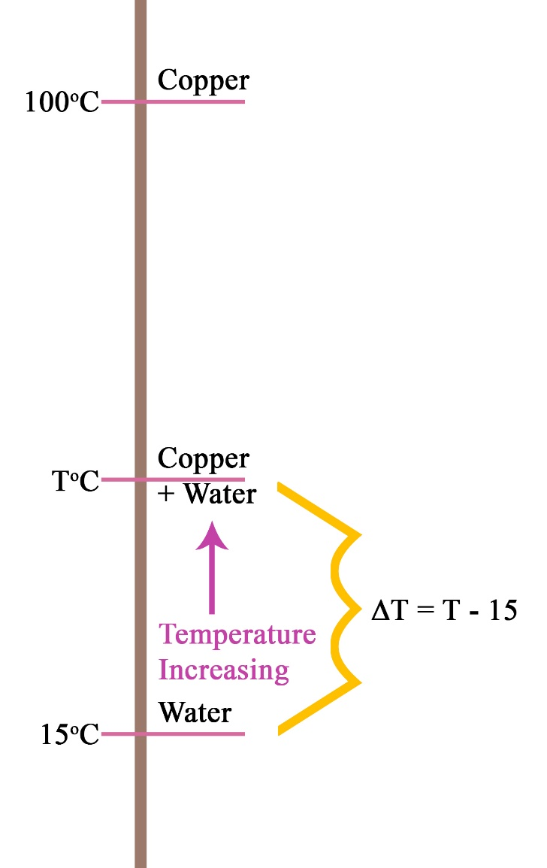
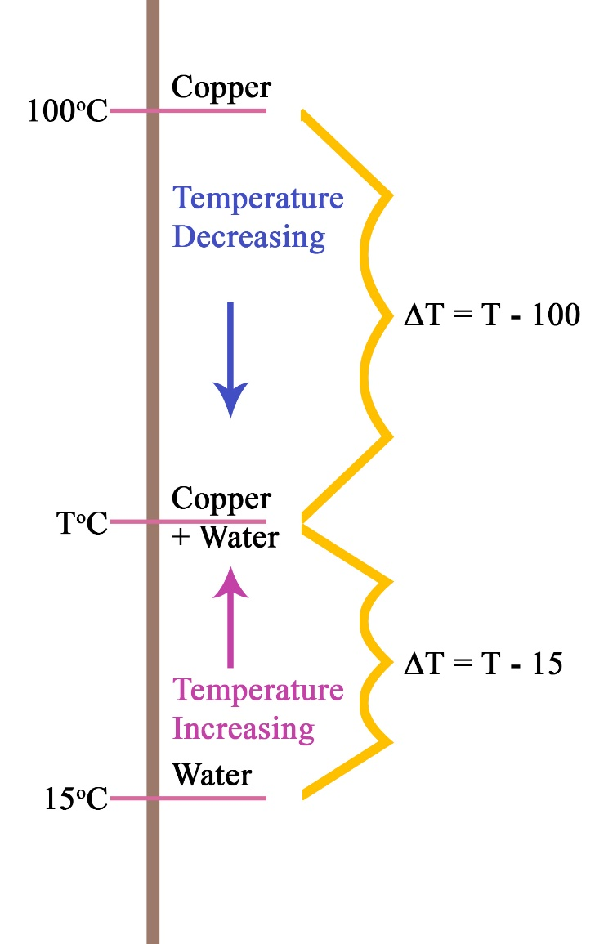
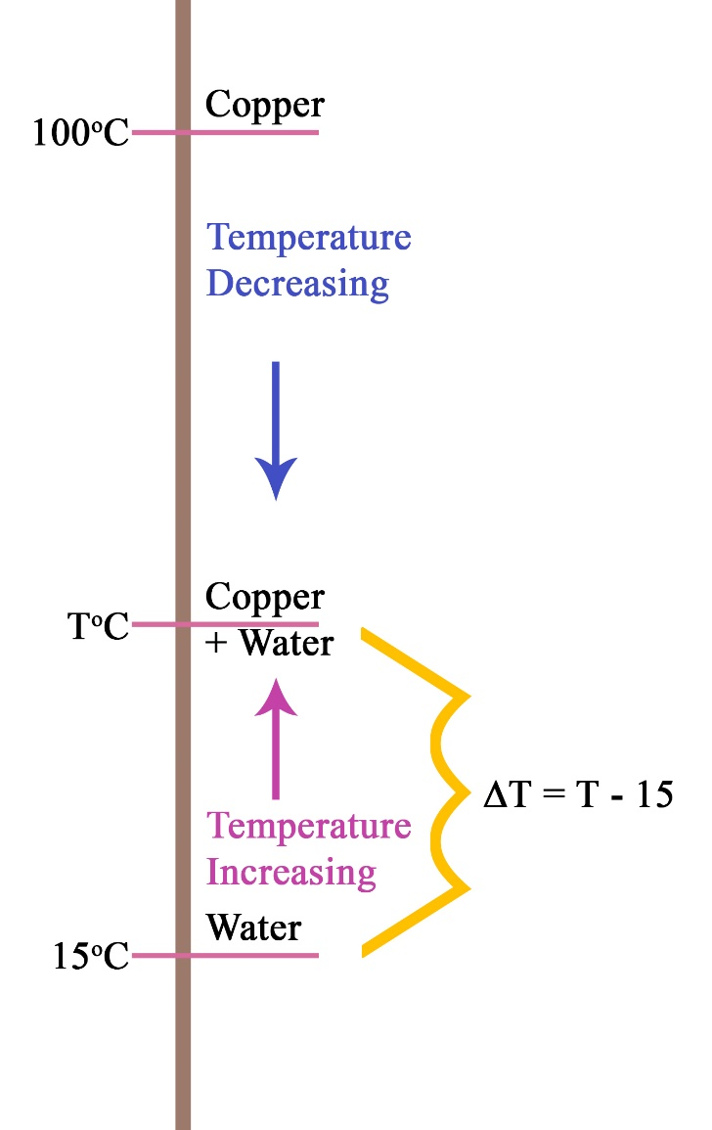
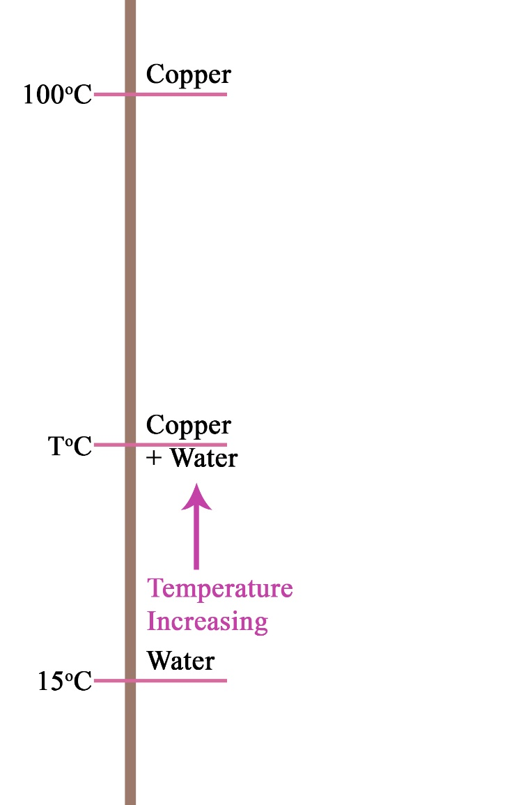

Example 1.3d
Step 2: Apply vector to the change in temperature component of the diagram.
Water increasing from 15ºC to TºC
ΔT = T_{f} – T_{i}
= T – 15
Copper decreasing from 100ºC to TºC
ΔT = T_{f} – T_{i}
= T – 100

Slide 41
Example 1.3d
Step 3: Understanding thermal equilibrium.
Heat loss by copper + Heat gained by water = 0
This states that the loss + gain must equal out

Slide 42

Example 1.3d
Step 4: Apply the thermal equilibrium equation.
Solution
Heat loss (copper) + Heat gained (water) = 0
m_{c} × c_{c} × ∆T + m_{w} × c_{w} × ∆T = 0
0.65×390×(T-100) + 0.5×4180×(T-15) = 0
253.5 (T-100) + 2090 (T-15) = 0
253.5T – 25350 + 2090T – 31350 = 0
253.5T + 2090T – 31350 – 25350 = 0
2343.5 T – 56700 = 0
2343.5 T = 56700
T = 56700
2343.5
T = 24.19 ºC
Hence the final (equilibrium) temperature of the Copper and Water is 24.2ºC

Slide 43
RADIATOR
Why is Water used as the coolant?
Because water has a high specific heat capacity, it can take away a lot of energy without boiling away.

Slide 44


Scuba Diver
A scuba diver in the sea is surrounded by water colder than they are. Water has a specific heat capacity of 4180 J kg⁻¹ K⁻¹.
A scuba diver on land is surrounded by air colder than they are. However air has a specific heat capacity of 1010 J kg⁻¹ K⁻¹.
Assuming the mass of the person is unchanged and the temperature of the water and the air are the same. Hence the only factor different is the specific heat capacity. Since water is 4 times greater, hence the energy removed from the person in the water 4 times more.

Slide 45
Example 1.3e
What happens when the system is not fully isolated.
Example
200 g of water at 10⁰C is added to 400 g of water at 50⁰C that is already sitting in an a 200 g metal can of specific heat capacity 400 J kg⁻¹ K⁻¹. What will be the temperature of the water immediately after thorough mixing has occurred?
Assumptions
This system (hot water, cold water and can) are isolated from external factors.
Since the hot water is sitting in the can already, then assume the can is also at 50ºC

Slide 46
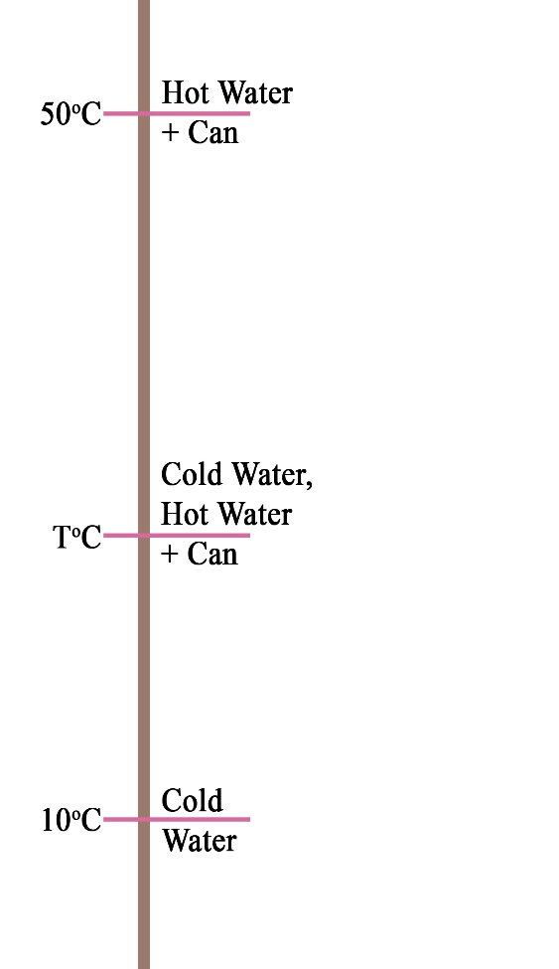
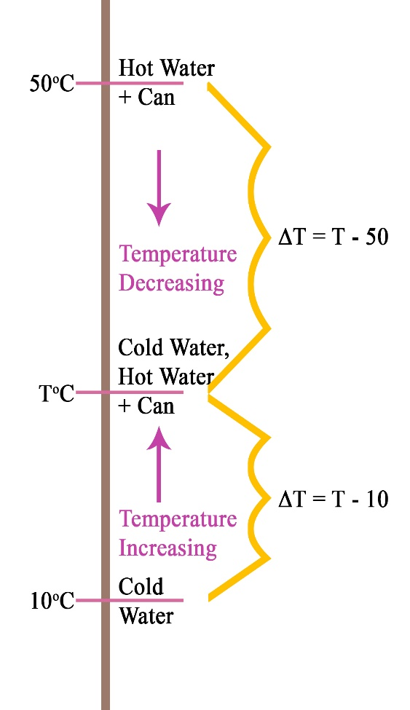
Example 1.3e
C_{can} = 400 J kg⁻¹ K⁻¹ and C_{water} = 4180 J kg⁻¹ K⁻¹
Solution
Heat loss (hot water+can) + Heat gained (cold water) = 0
m_{c}×c_{c}×∆T + m_{hw}×c_{hw}×∆T + m_{cw} × c_{cw} × ∆T = 0
0.2×400×(T-50) + 0.4×400×(T-50) + 0.2×4180×(T-10) = 0
80T - 4000 + 160T - 8000 + 836T - 8360 = 0
80T + 160T + 836T - 4000 - 8000 - 8360 = 0
1076T – 20360 = 0
1076 T = 20360
T = 20360
1076
T = 18.92 ºC

Slide 47
Homework, Context & Keywords
Context: How is this content used to better society?
The understanding of how different materials absorb energy and the rates at which they do this helps develop better technology to improve the environmental effects to humans.

Slide 48
Homework, Context & Keywords
Key Words
Specific Heat Capacity
Specific Heat

Slide 49
Homework, Context & Keywords
Homework
Complete all questions from Set 1.3 - due first lesson next week.
Read Chapter 1.4, page 20-30 and answer
Q1,2&3 Set 1.4
by next lesson.

Slide 50
Page Setup
Set up the first page of every lesson like this and rule a column line for every page after the first page that is used during the lesson.
Focus: State the Chapter Number, Title and the page numbers (3 lines).
Keywords: During the lesson write out your own keywords used during the lesson. (8 lines)
Context: During the lesson write in this section what this topic relates to in the ‘real’ world. How is this content used to better society? (5 lines)

Slide 51
Latent Heat
Chapter 1.4 page 20-30
2 lessons

Slide 52
Latent Heat
Latent heat is where energy (heat) is continually applied to the body, however, instead of a change in temperature occurring, there is a change in state.
The applied heat is absorbed by the particles, as potential energy, as they move further apart from each other.

Slide 53
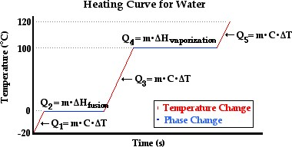
Ice ↔ Water ↔ Steam

Slide 54
Latent Heat of….
The Latent Heat of Fusion is the amount of heat (energy) required to convert 1 kg of a Solid completely into a Liquid (or a Liquid into a Solid), without a change in temperature occurring.
The Latent Heat of Vaporisation is the energy required to convert 1 kg of a Liquid completely into Vapour (or Vapour into Liquid), without a change in temperature occurring. This is known as the Boiling Point of the Liquid, and is tallied at the Standard Atmospheric Pressure.

Slide 55
Latent Heat Formula
Q = mL
Q = energy (J)
m = mass (kg)
L = specific latent heat (J kg⁻¹)
Water L_{fusion} = 3.34 x 10⁵ J kg⁻¹
L_{vaporisation} = 2.26 x 10⁶ J kg⁻¹
Q = mL

Slide 56
Example 1.4a
A 2 kW kettle holds 2 litres of water, initially at 20 ⁰C. How long will it be before a quarter the water has boiled away, assuming that there are no heat losses?
Solution
Step 1: Time to raise the temperature from 20 to 100⁰C
Q = m_{w}c_{w}ΔT
= 2 x 4200 x 80
= 672 000J
Power = Energy ÷ time
time = Energy ÷ Power
= 672 000 ÷ 2000
= 336 seconds

Slide 57
Example 1.4a
A 2 kW kettle holds 2 litres of water, initially at 20 ⁰C. How long will it be before a quarter the water has boiled away, assuming that there are no heat losses?
Solution
Step 2: Time to boil away 0.5 kg of the water
Q = mL_{v}
= 0.5 x 2 250 000
= 1125000 J
Power = Energy ÷ time
time = Energy ÷ Power
= 1125000 ÷ 2000
= 562.5 seconds
TOTAL TIME = 336 + 562.5 = 898.5 seconds

Slide 58
Example 1.4b
A basket-baller attains a high metabolic rate during a game and much of the excess heat generated must be lost bt sweating. During such a game Andrew develops excess heat at a rate of 800 W. If 90% of this heat must be lost by sweating, calculate the mass of the sweat produced in a 10 minute session. Assume the Latent Heat of sweat is 2.4 x 10⁶ J kg⁻¹.
Solution
m = ?
L = 2.4 x 10⁶ J kg⁻¹
t = 10 minutes = 600 seconds
P = 800 W
E = Q (both are energy measured in Joules)

Slide 59
Example 1.4b
P = Energy = Q
time t
؞ Q = P x t = 800 x 600 = 4.8 x 10⁵ J
only 90% of this is lost by sweat
Q_{sweat} = 90% x 4.8 x 10⁵ J = 4.32 x 10⁵ J
Also Q_{sweat} = m L_{v}
Hence m = L = 2.4 x 10⁶ = 0.18 kg
Q_{sweat} 4.32 x 10⁵
Hence 180 g of sweat is lost

Slide 60
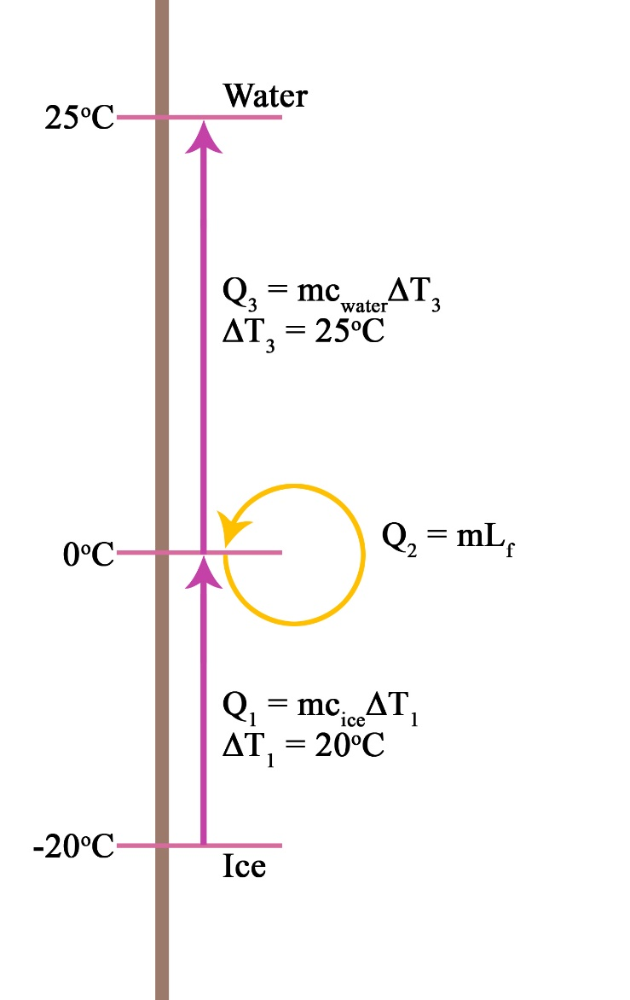
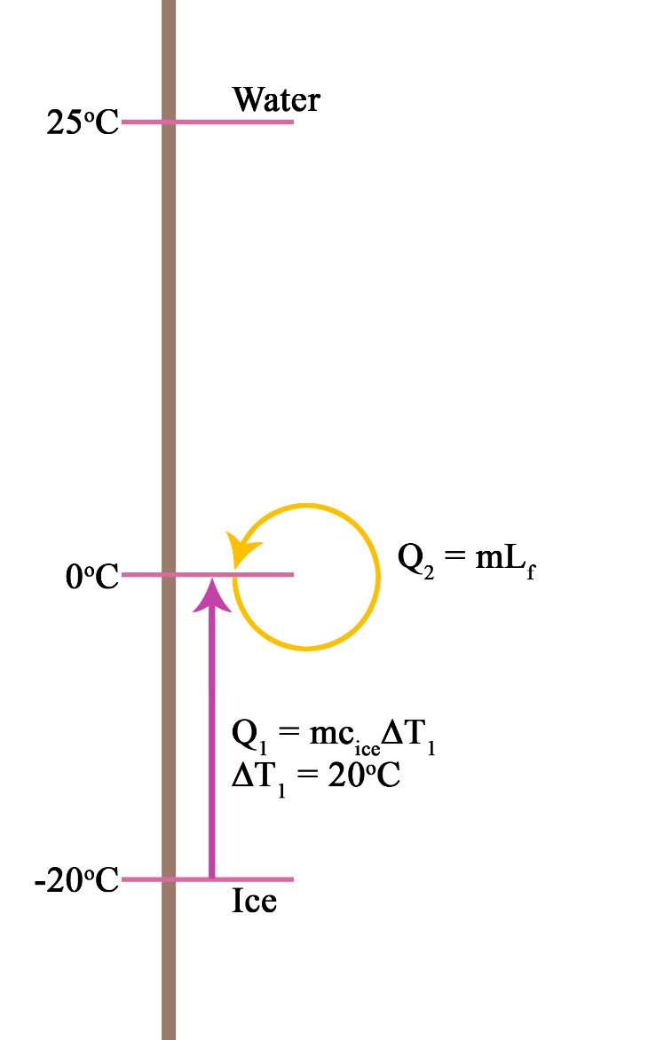
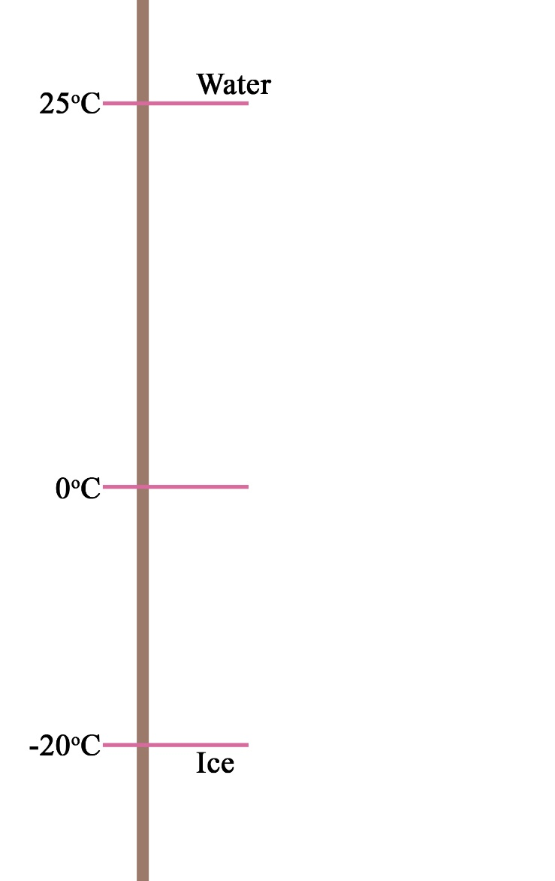
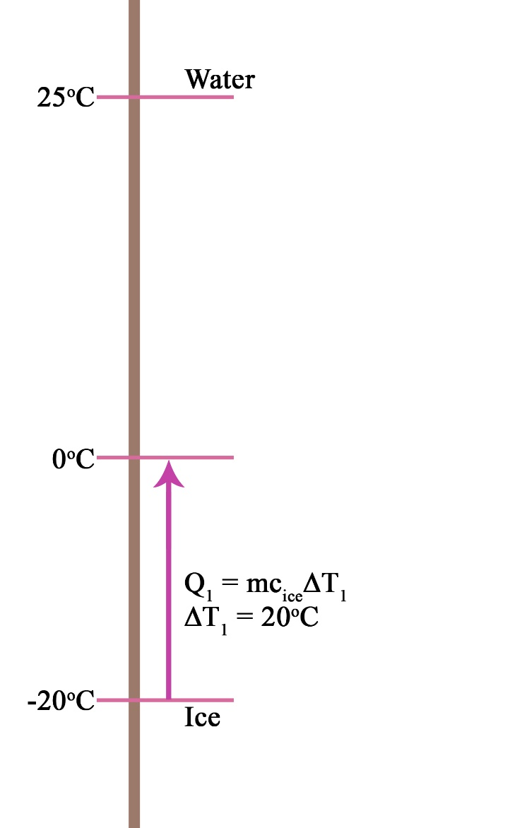
Example 1.4c
Determine the amount of energy required to change 250g of ice at -20 ºC to water at 25 ºC.
m = 0.25kg
Q₃: c_{water} = 4.18 × 10³ J kg⁻¹ K⁻¹
Q₃ = 0.25 × 4.18 × 10³ × 25
= 2.61 × 10⁴ J
Q₂: L_{fusion} = 3.34 × 10⁵ J kg⁻¹
Q₂ = 0.25 × 3.34 × 10⁵
= 8.35 × 10⁴ J
Q₁: c_{water} = 2.1 × 10³ J kg⁻¹ K⁻¹
Q₁ = 0.25 × 2.1 × 10³ × 20
= 1.05 × 10⁴ J
Q_{total} = Q₁ + Q₂ + Q₃
= 1.20 × 10⁵ J

Slide 61
Example 1.4d
In order for Silver to bind uniformly with copper to make Sterling Silver, it must first be brought to a gaseous state and then cooled. How much energy is required to get 6.4 kg of Silver to a gaseous state from room temperature (22 ºC) given the following data on Silver.
Melting Point of Silver = 961 ºC
Boiling Point of Silver = 2193 ºC
Latent Heat of Fusion of Silver = 8.8 x 10⁴ J kg⁻¹
Latent Heat of Vaporisation of Silver = 2.3 x 10⁶ J kg⁻¹
Specific Heat of Silver in Solid State = 2.3 x 10² J kg⁻¹ K⁻¹
Specific Heat of Silver in Liquid State = 14 J kg⁻¹ K⁻¹

Slide 62
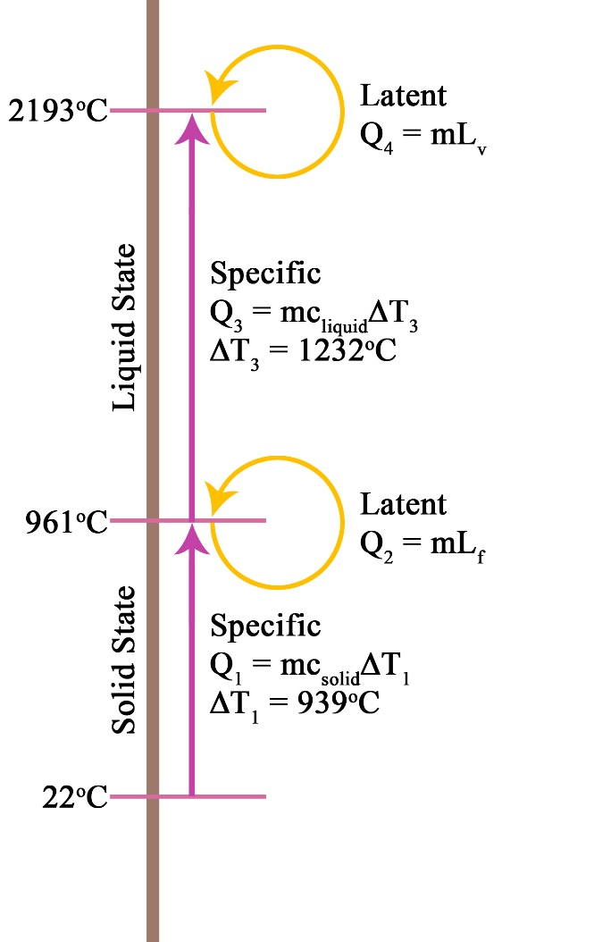
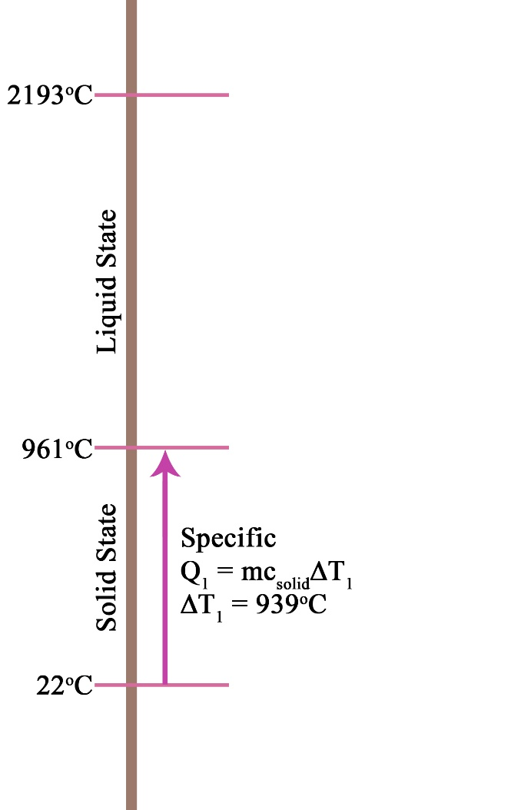
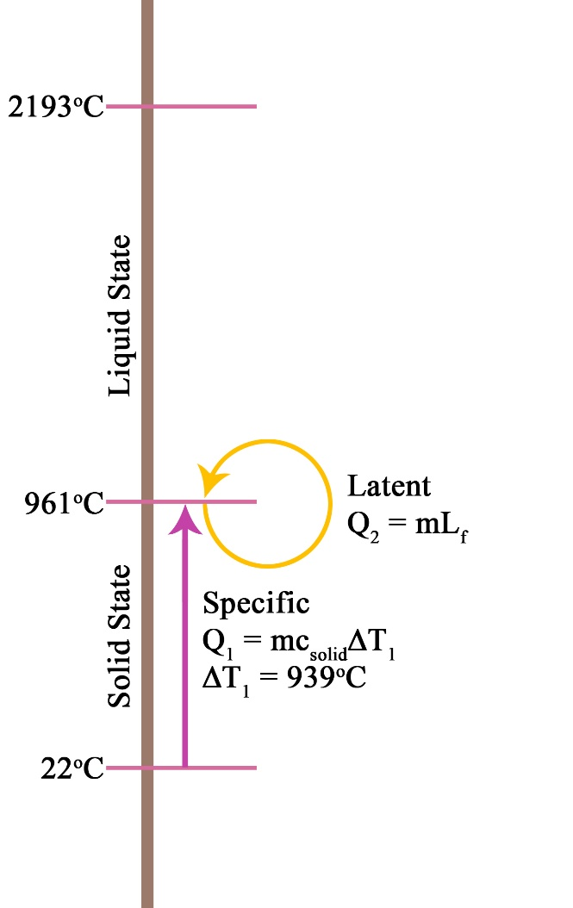
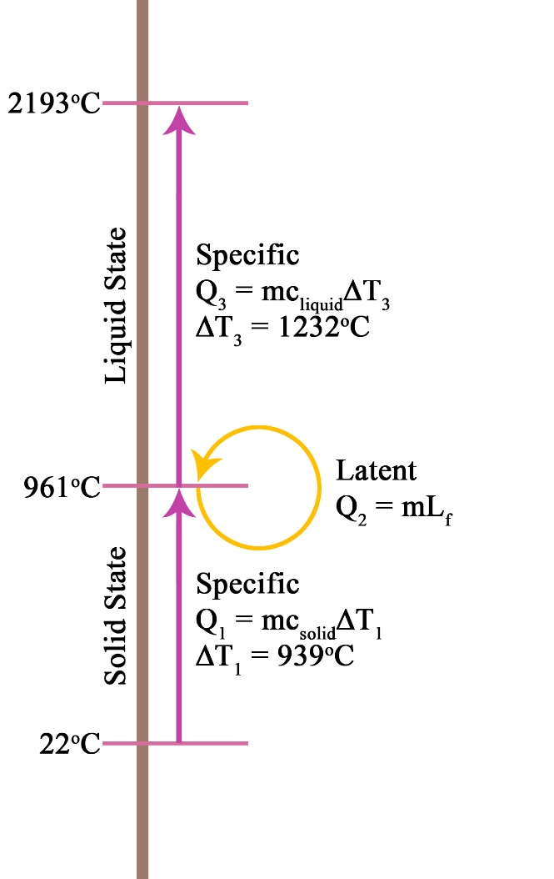
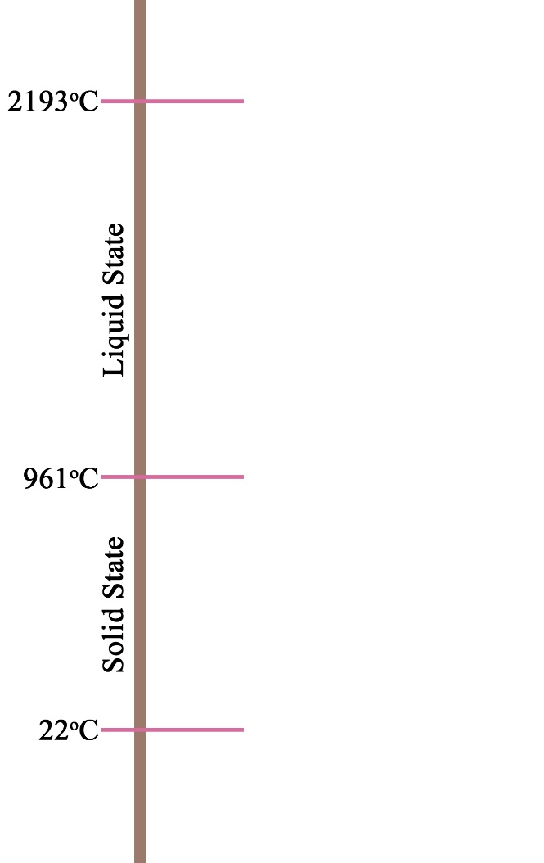
Example 1.4d
m = 6.4kg
Q₄ = 6.4 x 2.3 x 10⁶ = 1.472 x 10⁷ J
Q₃ = 6.4 x 14 x 1232 = 1.104 x 10⁵ J
Q₂ = 6.4 x 8.8 x 10⁴ = 5.632 x 10⁵ J
Q₁ = 6.4 x 2.2 x 10² x 939 = 1.382 x 10⁶ J
Q_{total} = Q₁ + Q₂ + Q₃ + Q₄
= 1.68 x 10⁷ J

Slide 63
Homework, Context & Keywords
Context: How is this content used to better society?
The understanding of how different materials absorb energy and change states helps develop better technology to improve the environmental effects to humans.

Slide 64
Homework, Context & Keywords
Key Words
Latent Heat Capacity
Vaporisation
Fusion

Slide 65
Homework, Context & Keywords
Homework
Complete all questions from Set 1.4 - due first lesson next week.
Read Chapter 2.1, page 36-44 and answer
Q1&2 Set 2.1
by next lesson.
Chapter 1 Review questions page 33 – 34 due first lesson next week.

Slide 66
Page Setup
Set up the first page of every lesson like this and rule a column line for every page after the first page that is used during the lesson.
Focus: State the Chapter Number, Title and the page numbers (3 lines).
Keywords: During the lesson write out your own keywords used during the lesson. (8 lines)
Context: During the lesson write in this section what this topic relates to in the ‘real’ world. How is this content used to better society? (5 lines)

Slide 67
Conduction Convection and Radiation
Chapter 2.1 page 36-44
2 lessons

Slide 68
The Nature of Heat
Heat moves in only one direction:
Under normal conditions and in nature, heat energy will ALWAYS flow the warmer object to the cooler object.
Heat energy will flow from one substance to another until the two substances have the same temperature (are in equilibrium).

Slide 69
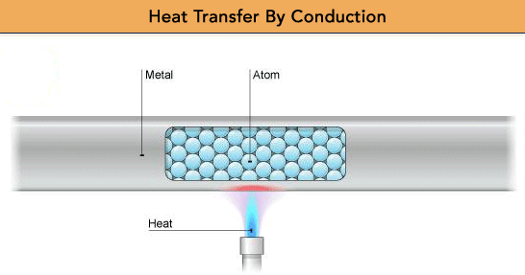
Conduction
Conduction is the transfer of thermal energy through the direct contact of particles.

Slide 70
Conduction
The faster moving particles in the warmer section collide with the slower moving particles in the cooler section.
As they collide, they give up some of their energy to the slower moving particles.
The slower moving particles gain thermal energy and pass it along to other particles.
Solids are better conductors than liquids, and liquids are better conductors than gases.

Slide 71
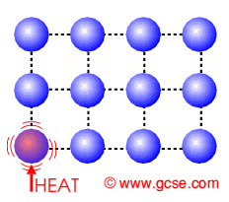
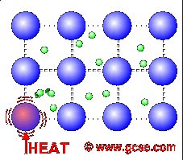
Conduction and Metals
The outer electrons of metal atoms drift, and are free to move.
When the metal is heated, this ‘sea of electrons’ gain kinetic energy and transfer it throughout the metal.
Insulators, such as wood and plastic, do not have this ‘sea of electrons’ which is why they do not conduct heat as well as metals.

Slide 72
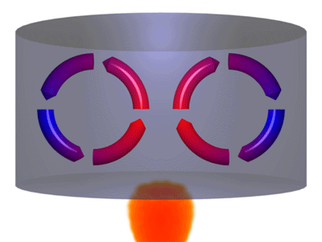
Convection
Convection is the transfer of thermal energy through currents.
Convection occurs in liquids and gases.
As liquids and gases gain thermal energy, they expand and decrease in density.

Slide 73
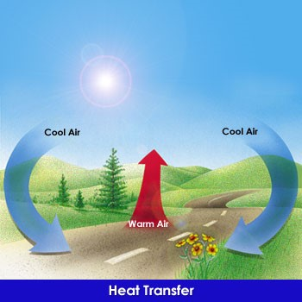
Convection

Slide 74
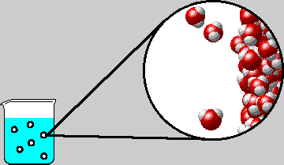
Evaporation has a cooling effect. How?
The more energy in a particle, the more it oscillates from its point of equilibrium making the spacing between the particles greater. This makes the particle less dense.
The faster moving particles (of high Kinetic energy) make their way to the surface (or their energy transfers
its way to the surface) and they
break free.
Molecules with high Kinetic
energy leave the liquid.

Slide 75
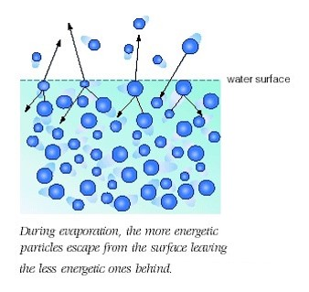
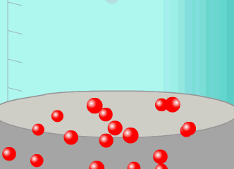
Evaporation has a cooling effect. How?
The average Kinetic Energy of the liquid drops during evaporation.
NOTE: Not all particles within the liquid have the same Kinetic Energy. This is why temperature is the measure of the average kinetic energy.

Slide 76
Radiation
The transfer of (thermal) energy by electromagnetic waves.
Radiation does not require matter to transfer thermal energy.
All the sun’s energy that reaches Earth travels through millions of kilometers of empty space (a vacuum).
All matter can radiate energy.
You feel the radiation of thermal energy from a bonfire, a heat lamp and a light bulb.

Slide 77
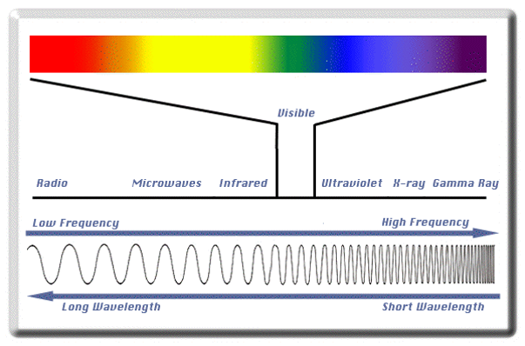
Radiation

Slide 78
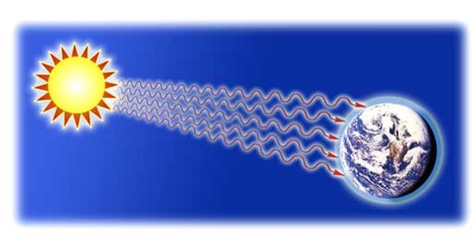
Radiation

Slide 79
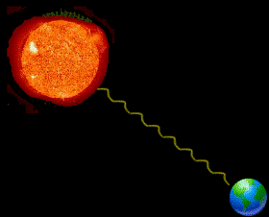
Radiation
The Sun is a major source of heat energy on Earth.
Have you ever wondered how the Sun warms us? Radiation from the Sun travels easily through space and when it reaches the Earth, it warms the ground and the air by converting potential energy to kinetic energy of the particles on Earth.
The Sun is not the only thing that gives out radiation. All objects give out radiation including humans.

Slide 80
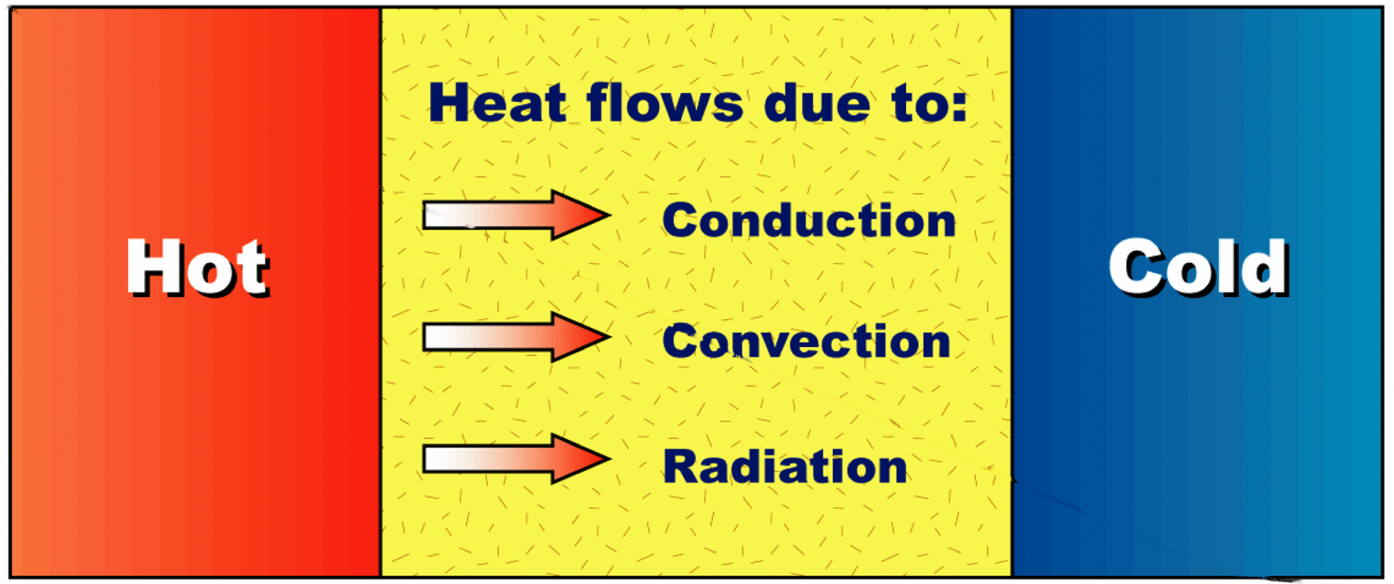
Heat transfer
Heat energy always moves from a warmer object to a cooler object. This flow of heat is called heat transfer.
There are three ways in which heat energy can be transferred:
Conduction – the passing of heat from the warmer end of an object to a cooler end.
Convection – the movement of heated particles in a liquid or gas from a warmer area to a cooler area.
Radiation – the emission of particles or waves from a warm object, e.g. the Sun.

Slide 81
Conduction
Radiation
Convection
Direct contact of particles
Solids/liquids/gases
The handle of a cooking utensil
Transfer of energy by waves
Only radiant energy that is absorbed becomes thermal energy
Lightbulb
Fireplace
Transfer of energy by bulk movement of matter (fluids)
Currents (wind,water)
Hot air balloon

Slide 82
Homework, Context & Keywords
Context: How is this content used to better society?
The understanding of the environment in order to develop better technology to improve the environmental effects to humans.

Slide 83
Homework, Context & Keywords
Key Words
Conduction
Convection
Radiation
Electromagnetic family

Slide 84
Homework, Context & Keywords
Homework
Complete all questions from Set 2.1 - due first lesson next week.
Read Chapter 2.2, page 45-47 and answer
Q1&2 Set 2.2
by next lesson.

Slide 85
Page Setup
Set up the first page of every lesson like this and rule a column line for every page after the first page that is used during the lesson.
Focus: State the Chapter Number, Title and the page numbers (3 lines).
Keywords: During the lesson write out your own keywords used during the lesson. (8 lines)
Context: During the lesson write in this section what this topic relates to in the ‘real’ world. How is this content used to better society? (5 lines)

Slide 86
Conservation and Efficiency
Chapter 2.2 page 45-47

Slide 87
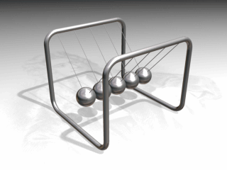
Conservation of Energy
Law of Conservation of Energy states: every is neither created nor destroyed, however it is transferred or transformed.

Slide 88
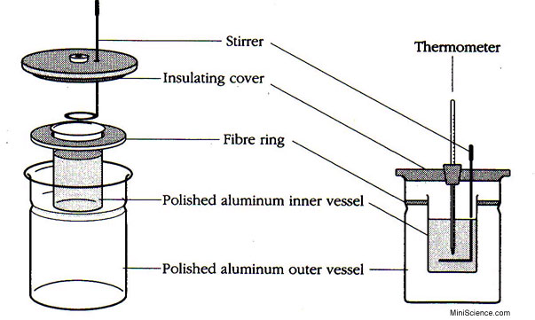
Closed System
Closed systems are systems isolated from
their environment. Example is a calorimeter.

Slide 89
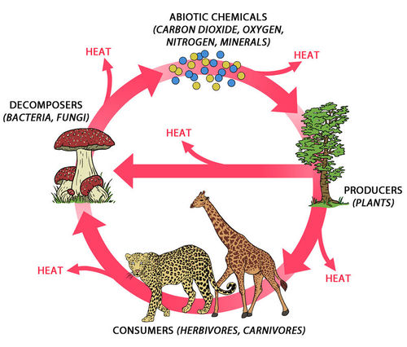
Open System
Open systems are systems that allow energy to move across boundaries.

Slide 90
Energy Efficiency (Ƞ)
Ƞ = energy output × 100%
energy input
= useful work output × 100%
total work input
NOTE: Objects releasing or obtaining heat are usually experiencing high inefficiencies

Slide 91
Example 2.2 a
A motor car engine converts the chemical energy stored in petrol into heat and mechanical energy. Typically, it converts 35 MJ of energy for each litre of petrol consumed. On average, for a particular car, 25 MJ of this energy is given up as heat losses, mainly through the radiator and hot exhaust gases. The remainder provides the mechanical energy to keep the car moving.
Write out the parameters.
Solution
Input energy = 35 MJ
Heat losses = 25 MJ
Output energy = 10 MJ

Slide 92
Example 2.2 a
Input energy = 35 MJ,
Heat losses = 25 MJ
Output energy = 10 MJ
Calculate the efficiency of this car in providing mechanical energy.
Typically, due to other internal losses, such as drive train friction, only 90% of the mechanical energy provided by the motor is available as power to the wheels. Calculate the overall efficiency of the car in providing energy of movement.
The cars manufacturer quotes a fuel consumption of 12.0 L of petrol per 100 km. Calculate how much energy is supplied to power the wheels for each kilometre of travel.

Slide 93
Example 2.2 a
Input energy = 35 MJ,
Heat losses = 25 MJ
Output energy = 10 MJ
Calculate the efficiency of this car in providing mechanical energy.
Solution
Ƞ = energy output × 100%
energy input
= 10 × 100%
35
= 28.6 %

Slide 94
Example 2.2 a
Input energy = 35 MJ, Heat losses = 25 MJ
Output energy = 10 MJ, Ƞ = 28.6 %
Typically, due to other internal losses, such as drive train friction, only 90% of the mechanical energy provided by the motor is available as power to the wheels. Calculate the overall efficiency of the car in providing energy of movement.
Solution
Ƞ = 90 % of the 28.6 % efficiency
= 90 % × 28.6 %
= 25.7 %

Slide 95
Example 2.2 a
Input energy = 35 MJ, Heat losses = 25 MJ
Output energy = 10 MJ, Ƞ_{motor} = 28.6 %, Ƞ_{wheels} = 25.7 %
The cars manufacturer quotes a fuel consumption of 12.0 L of petrol per 100 km. Calculate how much energy is supplied to power the wheels for each kilometre of travel.
Solution
Firstly, how much energy per kilometre
Fuel input per km = 35 (MJ per L) × 12 (L per 100 km)
= 35 (MJ per L) × 0.12 (L per km)
= 4.2 MJ / km
Only 25.7% of this goes to the wheels
Energy to wheels = 25.7 % × 4.2 MJ / km
= 1.1 MJ / km

Slide 96
Homework, Context & Keywords
Context: How is this content used to better society?
The understanding of how efficient energy is in order to conserve or create an efficient system.

Slide 97
Homework, Context & Keywords
Key Words
Open System
Closed System
Conservation of energy
Energy input
Energy output

Slide 98
Homework, Context & Keywords
Homework
Complete all questions from Set 2.2 - due first lesson next week.
Read Chapter 2.3, page 48-50 and answer
Q1,2&3 Set 2.3
by next lesson.

Slide 99
Page Setup
Set up the first page of every lesson like this and rule a column line for every page after the first page that is used during the lesson.
Focus: State the Chapter Number, Title and the page numbers (3 lines).
Keywords: During the lesson write out your own keywords used during the lesson. (8 lines)
Context: During the lesson write in this section what this topic relates to in the ‘real’ world. How is this content used to better society? (5 lines)

Slide 100
Energy Efficient Houses
Chapter 2.3 page 48-50

Slide 101
Homework, Context & Keywords
Context: How is this content used to better society?
The understanding of how energy efficient designs/systems can be incorporated into a house in order to conserve or create an efficient house.

Slide 102
Homework, Context & Keywords
Key Words
Energy Efficiency

Slide 103
Homework, Context & Keywords
Homework
Complete all questions from Set 2.3 - due first lesson next week.
Read Chapter 2.4, page 50-59 and answer
Q1&2 Set 2.4
by next lesson.

Slide 104
Page Setup
Set up the first page of every lesson like this and rule a column line for every page after the first page that is used during the lesson.
Focus: State the Chapter Number, Title and the page numbers (3 lines).
Keywords: During the lesson write out your own keywords used during the lesson. (8 lines)
Context: During the lesson write in this section what this topic relates to in the ‘real’ world. How is this content used to better society? (5 lines)

Slide 105
Energy Efficient Earth
Chapter 2.4 page 50-59

Slide 106
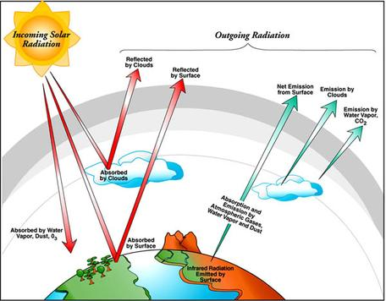
Earths Energy Balance

Slide 107
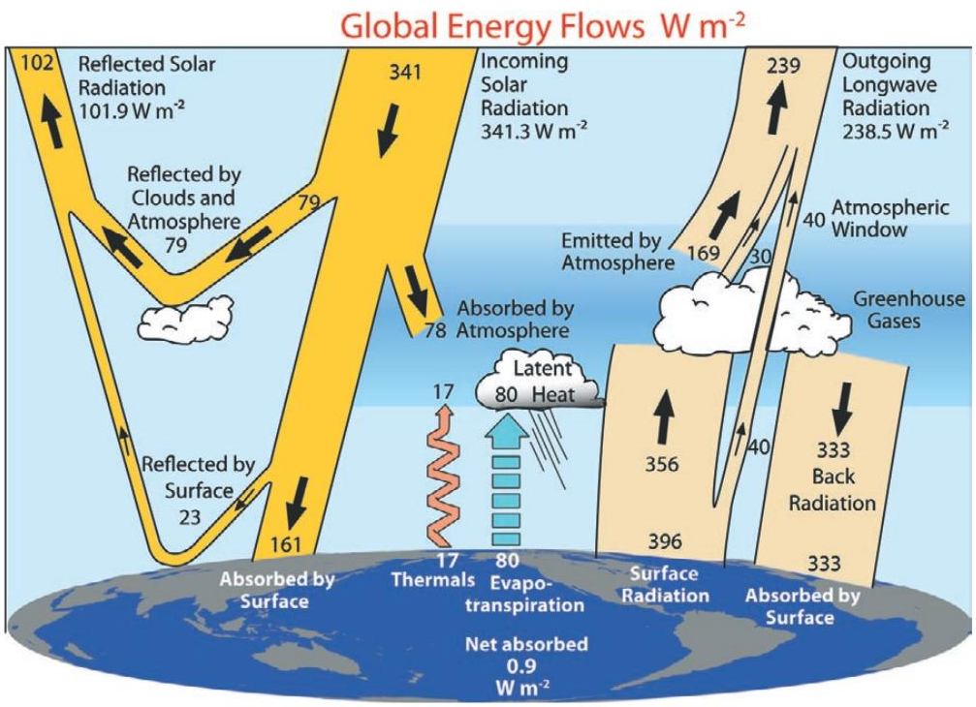
Earths Energy Balance

Slide 108
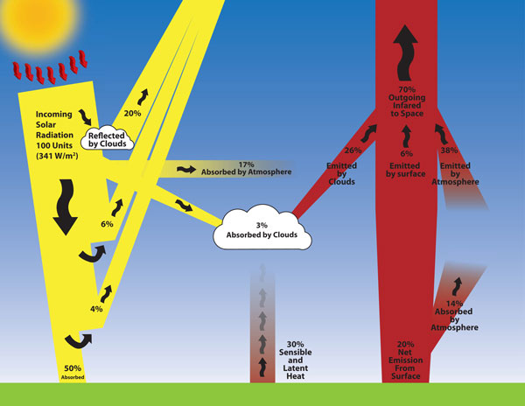
Earths Energy Balance

Slide 109

ONSHORE AND OFFSHORE BREEZES
By day the land heats up faster than the sea.
The land has a lower specific capacity than the water.
The land heats the air from below and convection currents rise
This drags in cooler air from over the sea – On Shore Breeze
The reverse happens by night

Slide 110
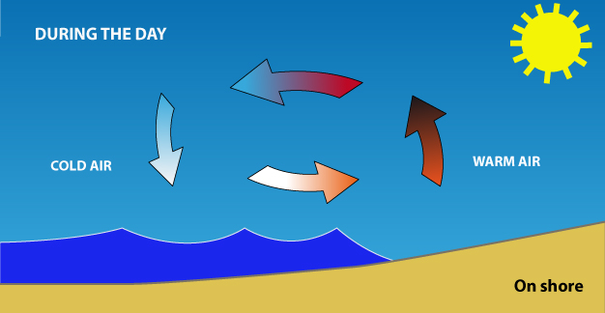
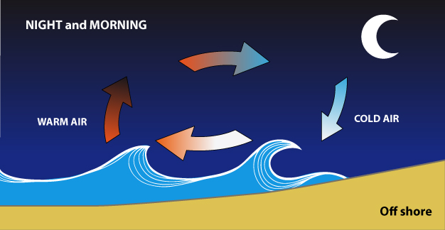
Sea Breeze and Fremantle Doctor

Slide 111
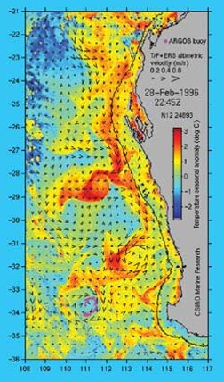
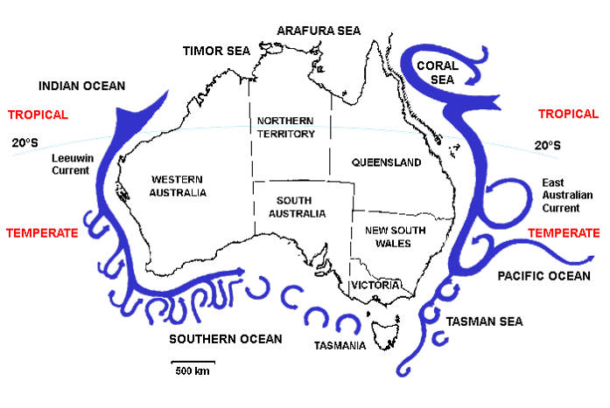
This satellite image shows surface ocean temperatures for West Australian waters. The warm Leeuwin Current brings tropical waters and marine fauna down the Western Australian coast.
Water in along the Perth region starts off at between 22 and 27⁰C.
Because water has a high specific heat capacity, it takes a long time to cool.
Even in winter the seas to the west of the Perth region are rarely below 20⁰C.

Slide 112
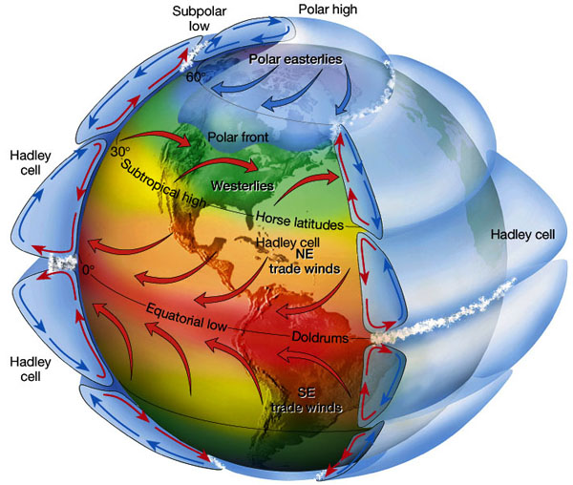
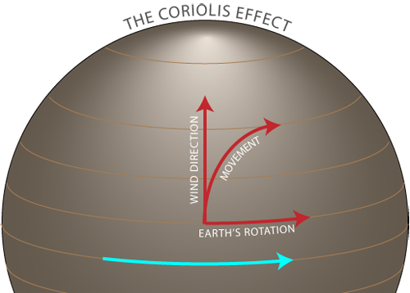
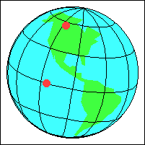

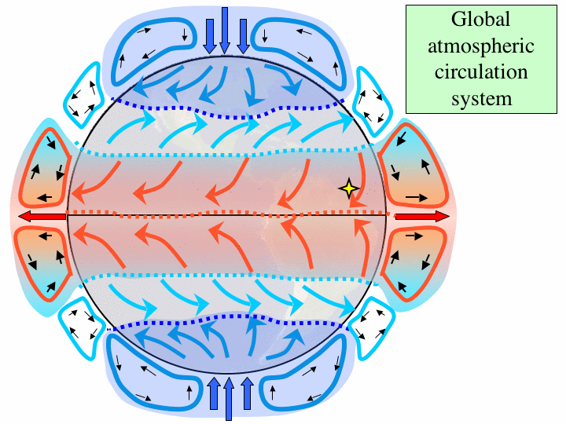
Coriolis Effect

Slide 113
Homework, Context & Keywords
Context: How is this content used to better society?
The understanding of our environment in terms of conservation of energy and weather patterns.

Slide 114
Homework, Context & Keywords
Key Words
Energy Balance
Energy Flow
Onshore wind
Offshore wind
Coriolis

Slide 115
Homework, Context & Keywords
Homework
Complete all questions from Set 2.4 - due first lesson next week.
Read Chapter 2.5, page 60-67 and answer
Q1&2 Set 2.5
by next lesson.

Slide 116
Page Setup
Set up the first page of every lesson like this and rule a column line for every page after the first page that is used during the lesson.
Focus: State the Chapter Number, Title and the page numbers (3 lines).
Keywords: During the lesson write out your own keywords used during the lesson. (8 lines)
Context: During the lesson write in this section what this topic relates to in the ‘real’ world. How is this content used to better society? (5 lines)

Slide 117
Work, Heat and Energy
Chapter 2.5 page 50-59

Slide 118
Calculations
Work = Force × Displacement (W = Fs)
Work (Joules)
Force (Newtons)
Displacement (Metres)
Power = Energy P = E
Time t
Power (Watts)
Energy (Joules)
Time (Seconds)

Slide 119
Example 2.5a
On a camping trip a family is boiling 3 L of water, initially at 20 ºC. The son suggests that the family use the gas stove instead of the wood fire, because the gas stove has a 5 kW output. The father decides to keep the water on the fire, noting it takes 5 minutes to boil. Who was correct?
Solution
ΔT = 80 ºC
t = 3 × 60
= 180 s
c = 4180 J kg⁻¹ K⁻¹
m = 3 kg
Q = m c ΔT
= 3 × 4180 × 80
= 1003200 J
Power (of fire) P = E ÷ t
= 1003200 ÷ 180
= 5573 W
(or 5.573 kW)
Hence the father was right

Slide 120
Homework, Context & Keywords
Context: How is this content used to better society?
Creating heating and cooling options that improve and maintain a healthy society.
The understanding of how efficient energy is related to power output in order to create efficiency in existing systems.

Slide 121
Homework, Context & Keywords
Key Words
Work
Power
Refrigeration
Internal Combustion

Slide 122
Homework, Context & Keywords
Homework
Complete all questions from Set 2.5 - due first lesson next week.
Read Chapter 2.6, page 68-69 and answer
Q1&2 Set 2.6
by next lesson.

Slide 123
Page Setup
Set up the first page of every lesson like this and rule a column line for every page after the first page that is used during the lesson.
Focus: State the Chapter Number, Title and the page numbers (3 lines).
Keywords: During the lesson write out your own keywords used during the lesson. (8 lines)
Context: During the lesson write in this section what this topic relates to in the ‘real’ world. How is this content used to better society? (5 lines)

Slide 124
Low Temperature Devices
Chapter 2.6 page 68-69

Slide 125
Low Temperature
Superfluid – zero viscosity, allowing it to move through any pores of a substance.
Superconductor – zero resistance, usually occurs when a material reaches it’s critical temperature.

Slide 126
Homework, Context & Keywords
Context: How is this content used to better society?
The understanding of how efficient energy is related to power output in order to create efficiency in existing systems.

Slide 127
Homework, Context & Keywords
Key Words
Superconductivity
Superfluidity

Slide 128
Homework, Context & Keywords
Homework
Complete all questions from Set 2.6 - due first lesson next week.
Chapter 2 Review questions page 72 due first lesson next week.
Semester 1 is completed.

